Slide 1

Eric Nickell

Slide 2

History
What is Feature Driven Development?
What is a Feature?
Feature Driven Development Roles
  Class Ownership
Feature Driven Development Process
  Mandated Code Inspections
Reporting
Summary
References

Slide 3

Original Creator: Jeff De Luca
  Singapore in late 1997
FDD evolved from an actual project
  Bank Loan Automation
  Luca was Project manager
  50 member developer team
  Peter Coad : Chief Architect
    1990’s object-oriented analysis and design expert

Slide 4

FDD is an agile software development process
FDD uses a short-iteration model
FDD combines key advantages of other popular agile approaches along with other industry-recognized best practices
FDD was created to easily scale to much larger projects and teams

Slide 5

Definition: small function expressed in client-valued terms
FDD’s form of a customer requirement

Slide 6
Feature naming template:
<action> the <result> <by|for|of|to> a(n) <object>
Examples:
  Calculate the total of a sale
  Validate the password of a user
  Authorize the sales transaction of a customer

Slide 7
Features are to be “small” in the sense they will take no more than two weeks to complete
Features that appear to take longer are to be broken up into a set of smaller features
Note: Two weeks is the maximum, most features take far less time (1 - 5 days)

Slide 8

Project Manager
Chief Architect
Development Manager
Domain Experts
Class Owners
Chief Programmers

Slide 9

Class assigned to specific developer
Class owner responsible for all changes in implementing new features
Collective Ownership
  Any developer can modify any artifact at any time
  addresses problem of deadlock
Class Ownership does not imply exclusivity but only responsibility

Slide 10
Advantages
  Someone responsible for integrity of each class
  Each class will have an expert available
  Class owners can make changes much quicker
  Easily lends to notion of code ownership
  Assists in FDD scaling to larger teams

Slide 11
Project Manager
Chief Architect
Development Manager
Domain Experts
Class Owners
Chief Programmers

Slide 12

Domain Manager
Release Manager
Language Guru
Build Engineer
Toolsmith
System Administrator
Tester
Deployer
Technical Writer

Slide 13

Process #1: Develop an Overall Model
Process #2: Build a Features List
Process #3: Plan By Feature
Process #4: Design By Feature
Process #5: Build By Feature

Slide 14
Project wide upfront design activities:
  Process #1: Develop an Overall Model
  Process #2: Build a Features List
  Process #3: Plan By Feature
  Goal: not to design the system in its entirety but instead is to do just enough initial design that you are able to build on

Slide 15
Deliver the system feature by feature:
  Process #4: Design By Feature
  Process #5: Build By Feature
  Goal: Deliver real, completed, client-valued function as often as possible

Slide 16
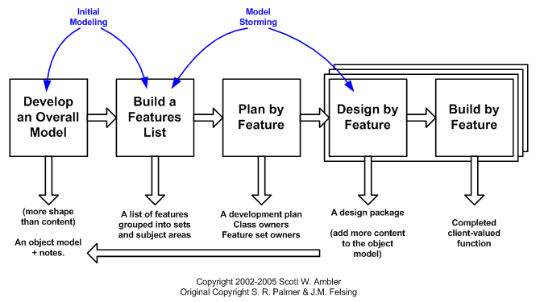

Slide 17
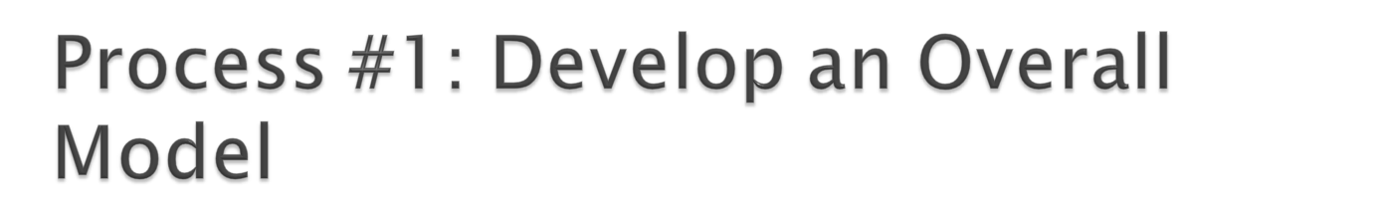
Form a modeling team
Domain walk-through
Build High-level object model
Record Notes
Goal - for team members to gain a good, shared understanding of the problem domain and build a foundation

Slide 18

All Features are organized in a three level hierarchy :
  Domain Subject Area
    Business Activity
      Features

Slide 19

Construct initial schedule
  Formed on level of individual features
    Prioritize by business value
    Also consider dependencies, difficulty, and risks
Assign responsibilities to team members
  Determine Class Owners
  Assign feature sets to chief programmers

Slide 20

Form Feature Teams
Team members collaborate on the full low level analysis and design
Certain features may require teams to bring in domain experts
Teams need to update the model artifact to support their changes

Slide 21

Chief Programmers pick teams based on the current feature in development
Chief Programmers lead picked team
Usually 3 to 5 people
Upon completion of the current feature the team disbands
Each team will concurrently work on their own independent iteration
Possible to be on multiple teams at once

Slide 22
Form Feature Teams
Team members collaborate on the full low level analysis and design
Certain features may require teams to bring in domain experts
Teams need to update the model artifact to support their changes

Slide 23

Implement designed feature
Test feature
  Unit-level
  Feature-level
Mandated Code Inspections
Integrate with regular build

Slide 24

Two Main Reasons
  Research has shown that when done properly, inspections find more bugs as well as different types of bugs than any other form of testing
  Great learning experience

Slide 25


FDD emphasizes the ability to provide accurate, meaningful, and timely progress information to all stakeholders within and outside the project
Feature Milestones

Slide 26

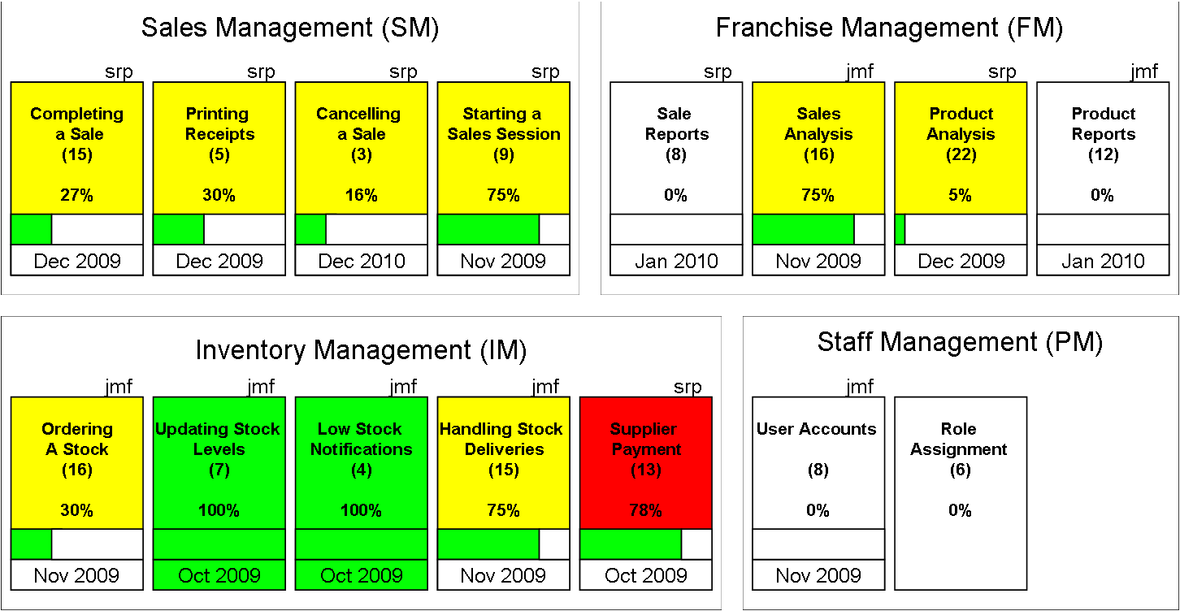
Parking Lot Chart

Slide 27

FDD combines many of the best practices of other agile models
FDD was initially created for and is more geared towards large project teams
FDD puts less focus on initial design and quickly gets to the point where the team can deliver new functionality to the project feature by feature

Slide 28

[1] Palmer, Stephen. "FDD History." N.p., 2010. Web. 27 Mar 2010. <http://www.step-10.com/SoftwareProcess/FeatureDrivenDevelopment/FDDHistory.html>.
[2] Ambler, Scott. "Feature Driven Development (FDD) and Agile Modeling." Agile Modeling. N.p., 2005-2009. Web. 27 Mar 2010. <http://www.agilemodeling.com/essays/fdd.htm>.
[3] Palmer, Stephen. "An Introduction to Feature-Driven Development." DZone. N.p., 11/20/2009. Web. 27 Mar 2010. <http://agile.dzone.com/articles/introduction-feature-driven>.
[4] Palmer, Stephen. "An Introduction to Feature-Driven Development – Part 2." DZone. N.p., 11/20/2009. Web. 27 Mar 2010. <http://java.dzone.com/articles/introduction-feature-driven-2>.
[5] De Luca, Jeff. "The Latest FDD Processes." Nebulon. N.p., n.d. Web. 27 Mar 2010. <http://www.nebulon.com/articles/fdd/download/fddprocessesUSLetter.pdf>.
[6] Palmer, Stephen. "FDD: People." N.p., 2010. Web. 27 Mar 2010. <http://www.step-10.com/SoftwareProcess/FeatureDrivenDevelopment/FDDPeople.html>.

